Slide 1
Your Joint Replacement Journey
Pre-Surgical Education Class
Dr Jonathan J Vaux, DO
Orthopedic Surgeon

Slide 2
Class objectives
Review why and how surgery is performed
Review your expected hospital course
What does a typical post op recovery look like?
Discuss possible complications and how to minimize those risks

Slide 3
When to consider joint replacement surgery
Joint replacement surgery is recommended when all appropriate, non-surgical/ conservative measures have been considered.
Anti-inflammatories/ Over the counter medications
Physical therapy/ home exercises
Lifestyle modifications
Injections
Assistive devices for ambulation (ex: cane or walker)
Braces
Weight loss
If you have tried some or all of these treatments, your arthritic pain continues to bother you more days than not, and is negatively impacting your quality of life, it is likely time to consider joint replacement surgery
Notes:
Joint replacement surgery is recommended when all appropriate, non-surgical/ conservative measures have been considered. Take a moment to review which of these have been tried for the treatment of your arthritic joint

Slide 4
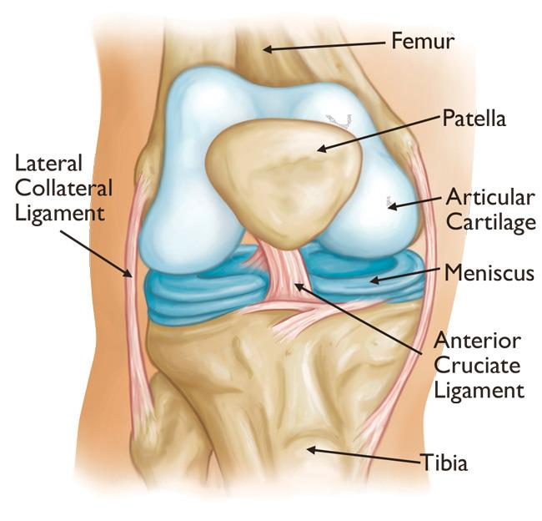
Knee anatomy overview
Femur (thigh bone)
Tibia (shin bone)
Patella (knee cap)
Cartilage: a smooth collagen that lines the ends of the bones and enables them to glide
Meniscus: rubbery shock absorber made of collagen

Slide 5
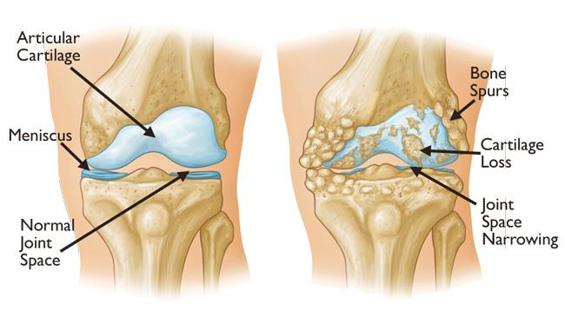
Knee Arthritis
“Wear and tear” condition in the knee, where your cartilage, meniscus, and/or bone degenerate and you have a rough surface grinding on another rough surface, causing pain
Types of Arthritis:
Osteoarthritis
Rheumatoid Arthritis
Post-traumatic arthritis

Slide 6
Total Knee Replacement
When more than one compartment of the knee are affected by arthritis, a total knee replacement is considered
Total Knee Replacement (TKA)
Damaged cartilage/bony surfaces are removed
Metal implants are sized to your bone
Implants are attached to the bone using bone cement
A plastic liner is placed in between. This is your “new cartilage”

Slide 7
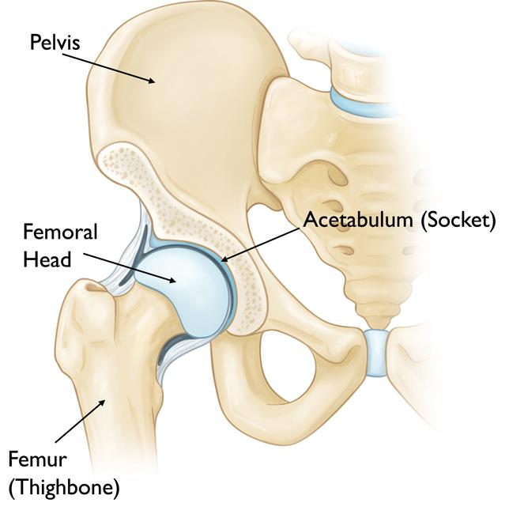
Hip Anatomy
“Ball and socket” joint
Femoral head (ball at top of thighbone)
Acetabulum (socket in pelvis)
These are held together by ligaments, muscles and soft tissue
Cartilage: a smooth collagen tissue that lines the ends of the bones and enables them to glide

Slide 8
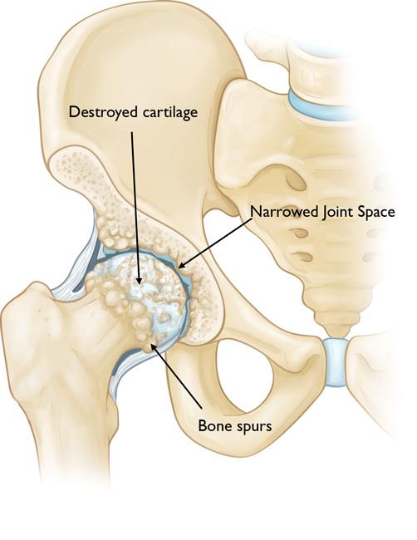
Hip Arthritis
“Wear and tear” of your hip joint, with inflammation and destruction of the cartilage tissue, leading to less “cushion” and formation of bone spurs and rough surfaces, often leading to stiffness and pain
Types of Arthritis
Osteoarthritis
Rheumatoid Arthritis
Avascular Necrosis
Other

Slide 9
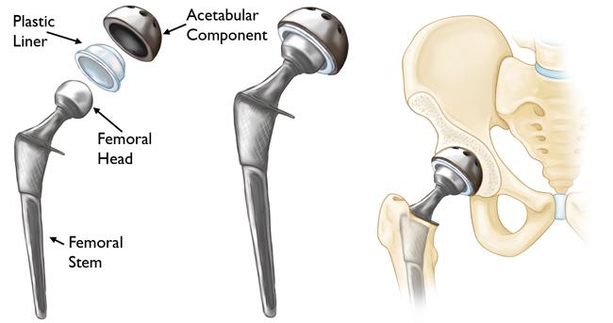
Hip Replacement
Femoral head (ball) is removed
Damaged acetabulum (socket) is removed and replaced with a metal cup
Metal stem is inserted into the hollow center of the femur with a smooth metal/ceramic ball attached
Plastic liner: this is your “new cartilage”

Slide 10
What Materials are used?
Hip Replacement*
Titanium stem and cup, coated with material to help the bone grow “onto” your implants so it becomes part of your body
Metal or ceramic head
Polyethylene liner (plastic)
Knee Replacement*
Titanium
Cobalt-Chrome Alloy
Polyetheylene liner (plastic)
*These are “typical” implants which are well-tested and have long track records, having been implanted hundreds of thousands of times without known recalls, but there are alternatives your surgeon may choose based on your specific anatomy.
*If you have a known metal sensitivity, please alert your surgeon as this may change the type of implant used

Slide 11
Preparing for Surgery
ALL patients must undergo pre-surgical testing & clearance prior to surgery.
Labs, EKG, clearance by your primary medical doctor
Designate a caregiver/ coach (spouse, friend, significant other, relative). They play a very important role in the success of your joint replacement.
Assistance at home for approximately 5 days – 2 weeks after surgery; help monitor medications (pain, anti-nausea, blood thinner); accompany you to pre & post op visits
Complete pre operative Physical Therapy (at any Everett Clinic Location)
To prepare you for post op recovery and rehabilitation and train you on how to use a walker, navigate stairs and other activities of daily living.
Notes:
ALL patients must undergo pre-surgical testing & clearance prior to surgery.
Labs, EKG, clearance by your primary medical doctor
Designate a caregiver/ coach (spouse, friend, significant other, relative). They play a very important role in the success of your joint replacement.
Assistance at home for approximately 5 days – 2 weeks after surgery (minimum of 5 days after surgery)
Help monitor medications (pain, anti-nausea, blood thinner)
Prepare meals, monitor activity, communicate with provider
Accompany you to pre & post op visits (we recommend your caregiver attend the pre op visit with your surgeon if at all possible)
Complete pre operative Physical Therapy (at any Everett Clinic Location)
To prepare you for post op recovery and rehabilitation and train you on how to use a walker, navigate stairs and other activities of daily living. This can be done at any Everett Clinic PT location.

Slide 12
Preparing for Surgery
Schedule Post Op Outpatient Physical Therapy (only for knee replacement)
Surgery at Providence Hospital: schedule outpatient PT to start 2 weeks after surgery.
(In-Home PT and a visiting nurse will be arranged for you after surgery for the first 2 weeks)
Surgery at Edmonds surgery center: schedule outpatient PT to start 5-7 days after surgery
**You MUST have a physical therapy appointment scheduled before your surgery occurs
Durable Medical Equipment
If surgery is done at Providence Hospital, this will be provided at discharge
If surgery performed at Edmonds Surgery Center, please obtain the following:
Front wheeled walker
Incentive spirometer (amazon)
Ice packs or cooling device

Slide 13
Preparing for Surgery
Dental Work:
Cancel any dental appointments 1 month PRIOR to surgery and 3 months AFTER surgery
If you have any loose teeth or pending dental work, let us know IMMEDIATELY.
** ALL dental work must be completed 4-6 weeks before surgery, as in rare cases it can lead to infection after surgery!
Prepare Your Home for Surgery:
Remove all small rugs or obstacles that may be in your path around your home
Create clear walking paths throughout your house (for your walker and to not trip!)
If possible, have a bed and bath on your main floor
If you have pets, consider having someone assist in their care for the first 1-2 weeks after surgery
Prepare meals ahead of time if needed for your first few day safter coming home. It’ll make your life easier!

Slide 14
Pre and Post Surgery nutrition
Recommended foods: fish, berries, fruits, vegetables, whole grains, greens, nuts, seeds.
Fried foods and highly processed foods before and after surgery are strongly discouraged. Avoid foods such as: red meat, sugars, saturated fats, simple carbohydrates, Example: macaroni and cheese, french fries, potato chips, salami, sausage, bacon, fast food hamburgers.
A high protein, anti-inflammatory diet has been correlated with improved outcomes after total joint replacement.
We recommend you consume 100g/day of protein (unless medically advised to have low-protein diet, such as in chronic kidney disease)
Notes:
The food you eat around the time of surgery can impact your outcome (approximately 2 weeks before and 6 weeks after surgery). These are general guidelines: If your regular doctor or gastroenterologist has you on a specific diet then you should continue to follow that.

Slide 15
Cleaning your body before surgery
Shower once daily for 5 days with Dyna-Hex 4 (Chlorhexidine gluconate) soap
The day before surgery:
One shower in the evening with the soap
Put on clean clothes or pajamas, and change your sheets
The morning of surgery: One more shower again with the soap
*if allergic, may use anti-bacterial soap
Use nasal ointment (2x daily for 5 days) and mouth wash as prescribed
Most studies show infections after total joint surgery come from the patient’s own skin bacteria, so this is an important part in decreasing your risk of getting an infection! Decolonization as outlined above has been shown to decrease the risk of a prosthetic joint infection substantially. See your packet or surgeons website for more info.

Slide 16
Hospital information
You will receive a call from the hospital or surgery center1-2 days before surgery. They will tell you:
Your check-in time, when to stop eating or drinking, etc
Make sure you are not taking any medications on your “Do not take” list before surgery (see instructions from your pre op appointment or your joint book/website)
*Note: There are times that the surgical schedule needs to be rearranged due to unforeseen circumstances and we may re-call you to change your arrival time – sometimes even on the day of the procedure itself – so please plan on answering your phone

Slide 17
Anesthesia during surgery
Most surgeries are done using Spinal anesthesia with additional “twilight” sedation so you aren’t awake during surgery (similar to a colonoscopy)
Some patients will receive general anesthesia due to their medical history or if surgery is performed at our ambulatory surgery center (ASC)
Benefits of spinal anesthesia
Often wake up easier with less side effects
Better pain control
Able to get up and move faster

Slide 18
The Surgery Day
Check in at Surgery Lobby
You will be taken to the Preoperative Holding area
You will meet your Surgeon and Anesthesiologist here
Operating Room (1.5-2.5 hours). Involves:
Anesthesia
Positioning
Surgical Procedure
Incision Closure
Reversal of Anesthesia
When your joint replacement surgery is complete, you will spend time in a post anesthesia care unit (PACU) (1-2 hours)

Slide 19
After Surgery / Going home
Before you are ready to go home, you will complete the following:
Physical Therapy or a nurse will work with you before discharge
Walking with you with a walker to ensure you are safe to return home (including stairs)
Medically Stable
Vital signs and labs (done the morning after surgery if overnight stay) must be within normal limits prior to discharge
Pain Management
Your pain should be at a tolerable level with oral medications prior to discharge
Medication Prescriptions will be provided at discharge

Slide 20
After Surgery / Going home
Feel well enough to eat solid food and drink liquids with no nausea or vomiting
Urination
Urination is difficult for some patients after anesthesia
We would like you to be able to void your bladder prior to discharging home
If you are unable to do so after several attempts, we may recommend placement of a catheter to be sent home with you and arrangements to follow up with your PCP
Constipation
You do not need to have a bowel movement in order to leave
The combination of anesthesia and pain meds slows your bowels. You will receive a stool softener to help with this, but it is not uncommon to not have a BM within 3-5 days after surgery. Lots of hydration, minimizing narcotics, and using stool softeners will help a lot!

Slide 21
Multimodal Post op pain Management
Ice / cryotherapy
Anti-inflammatory (ex: Meloxicam/Mobic) for 6 weeks
Some patients cannot tolerate NSAIDs for various reasons (kidney injury, GI intolerance, medication interactions)
Tylenol (Acetaminophen)
Take 1000mg 3x daily – this helps decrease the need for narcotics
Tramadol
Narcotic medication as-needed for severe pain (ex: Oxycodone)
* “Multi-modal” Pain Protocol: each medication acts on different pain pathways
Notes:
Your postoperative pain management regimen is an evidence-based multimodal pathway. Multi-modal means “acting on different pain pathways.” The whole goal is to stay ahead of the pain, rather than trying to play catch up since we know that is a hard game to play. We are very conservative here and give the lowest doses possible to avoid some of the side effects of these medications. Our goal is to cover you pain appropriately and safely, which is what we intend to do.

Slide 22
Cold therapy after surgery
Cold Therapy for your comfort
Ice packs help your pain and swelling much more than heat
You can use gel ice packs or even just a frozen bag of peas directly on your dressing
Ice for 20-30 minutes ON, and then 30 minutes off as much as possible throughout the daytime

Slide 23
Postoperative medication PLAN
Blood thinner to minimize risk of blood clots (May vary depending on your medical history)
Aspirin (ASA) 81mg 2x/ day for 35 days
Xarelto 10mg daily for 35 days (patients with history of blood clots or those who cannot tolerate aspirin
Post Op Antibiotic
For those at increased risk of infection (ex: diabetics, high BMI, autoimmune diseases, recent smokers) – you will take for 7 days
Same day discharge patients are sent home with 3 doses of antibiotics
Zofran (Ondansetron): to help with nausea after surgery
Stool Softener (Ex: Senna): to help with constipation after surgery

Slide 24
Postoperative medications

Slide 25
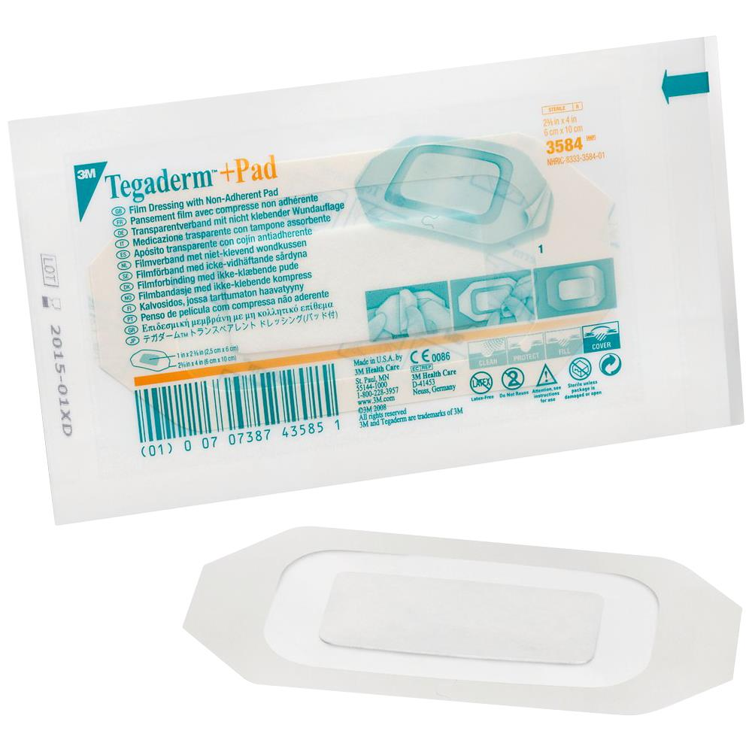
Incision & Dressing Care
Your skin is typically closed with dissolvable sutures and/or skin glue
A water-resistant dressing is then placed
Unless otherwise specified, keep your dressing clean and intact until your first post op appointment. Please refer to the Wound Care section of your Joint Book or see the website for further instructions
Bathing:
You may shower with this dressing 3 days after surgery, so long as dressing remains sealed and there is no drainage
avoid submerging in pools, tubs, or baths until cleared by your surgeon (approximately 6 weeks after surgery)
Tegaderm

Slide 26
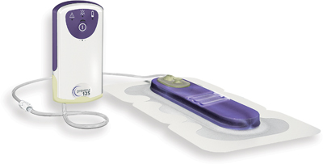
Incision & Dressing Care
Patients who are at higher risk for wound complications or infection may have Nylon sutures or Surgical Staples, that will be removed at your first follow-up appointment
Prevena Incisional Vac
Used for patients at higher risk for wound complications, often in revision joint replacements
Negative pressure vacuum suction seal. Stays in place for 7 days and prevents infection. After 7 days, the canister battery will stop working and you can remove and place a dry dressing. This peels off like a normal bandage.
Dressing Type #2: Prevena

Slide 27
Follow-up office visits
2-3 weeks Post-Surgery
Incision will be checked
X-Rays will be obtained to check on the position of your implants
If sutures/staples need to be removed, they will be removed at this visit
At this visit you will typically be checked by Dr Vaux’s Physician Assistant (PA)
6 weeks Post-Surgery
In clinic visit with your surgeon
Incision is checked to ensure complete healing
Range of motion check for total knee patients
4 months & 1 year: xrays and continue to check progress of return to full activity

Slide 28
Goals / typical post op recovery
Independent by 5 – 14 days after surgery (cane as needed but be safe and do not fall!)
2 – 3 weeks off narcotics
4 – 6 weeks back to work (depending on your job)
3 – 4 months (80-90% recovered)
1 – 2 years full recovery
Our goal is to get you back to the activities you want to do as quickly and safe as possible!
*keep in mind, each patient recovers at a different pace. Your recovery will depend on your pre operative ability/ severity of arthritis, age, overall functional level. Our focus is on steady and safe progress after surgery. Think marathon, not a sprint!

Slide 29
When Can I…?
Return to work? Answer: Depends on your job!
Light duty/desk job: 2-4 weeks after surgery
Heavy duty/Labor Intensive: 6-8 weeks post op
Drive?
3-4 weeks for most people to get your brake reaction time back
Must be off narcotic medications completely and feel safe. Practice in a parking lot first to ensure you are safe
Travel or Fly?
Preferably not until after your first post op/ wound check appointment
If / when you do, make sure to take frequent walking breaks to keep your blood flowing and prevent blood clots and stiffness

Slide 30
Potential risks and complications
Infection
We conduct surgery in a sterile environment, using medical-grade sterilized equipment, decolonize your body, give you antibiotics before surgery begins, and sterilize your skin before surgery. However, unfortunately infections can still occur
In most patients, this risk is approximately 1-2% so the risk is small. Some patients have risk factors that make this percentage higher, which is why it is important to optimize and decrease these surgical risks, and keep them controlled even after surgery (ex: blood sugar, body weight, cessation of smoking)
If an infection occurs, this typically takes at least one, and often two or more surgeries to resolve the infection.
Please refer to Dr Vaux’s website or AAHKS for more information on this risk

Slide 31
Potential risks and complications
Blood clots/pulmonary embolisms
Walking early and often after surgery minimizes this risk, along with the Aspirin or other blood thinner we have you take
Hematoma (blood collections)
Compressive dressings are important after surgery
Fracture
Nerve or vessel injury
Insomnia or waking up during the night
Studies show it takes up to 2 months for patients to be able to sleep through the night entirely after surgery

Slide 32
Potential risks and complications
Loosening/Failure/ “wearing out” of the implant
Most studies show the implants should last about 20 years
Leg length discrepancy: a small amount (few millimeters, typically much less than half-inch) after hip replacement
Instability/ Dislocation
After hip replacement, you will need to avoid certain positions to decrease this risk
“Clicking”: a little clicking is normal! (particularly with knee replacements)
Residual pain/stiffness:
This is an “artificial joint”/ new and replaced joint, not your 20-year-old joint!

Slide 33
Potential Risks & complications
Factors that increase your risk for complications:
Age
Obesity
Diabetes
Skin problems
Heart disease
Smoking
Kidney disease
Liver disease
Bleeding problems
GI problems
Previous infection
Narcotic use
Previous surgeries
High blood pressure
Alcohol
Sleep apnea
History of blood clots
Other medical co-morbidities

Slide 34
Symptoms after surgery
Common Symptoms:
You may see significant swelling and bruising throughout your entire leg
Warmth of the leg for several weeks after surgery
Redness around the dressing or joint
Low-grade temperatures (<101.5 is normal)
When to Call
Severe new pain in your calf (back of the shin bone)
Multiple temperatures above 101.5
Significant drainage staining more than half the dressing
Pain uncontrolled with medications
New redness that begins to spread. Redness is normal, but should slowly decrease in the weeks after surgery

Slide 35
What should I do now?
Stop medications as directed by your Surgeon/PCP/Pre-Anesthesia Clinic
Prepare living arrangements as directed in your Joint Book / Online
Schedule outpatient physical therapy to begin no later than 2 weeks after surgery (knee replacements)
Wash surgical area with Chlorhexidine Gluconate soap
Stay well hydrated and eat nutritious meals
RELAX! And know that you are in good hands!

Slide 36
Thank you
Please reach out with any questions!
MyChart for non-urgent queries
425-339-5447 to speak with your surgeon’s dedicated Nursing team
More information at: www.jonathanvauxdo.com

